Slide 1

Health Insurance – Cost Prediction
Team Members:
P Sree Lahari
P Skv Chaitanya
R Ananya
Sirisha A
Y P Venkatesh

Slide 2

About
Health insurance is an insurance that covers the whole or a part of the risk of a person incurring medical expenses, spreading the risk over a large number of persons.
By estimating the overall risk of health care and health system expenses over the risk pool, an insurer can develop a routine finance structure, such as a monthly premium or payroll tax, to provide the money to pay for the health care benefits specified in the insurance agreement.
There are different types of health insurance plans, such as individual health insurance, family health insurance, critical illness insurance, etc.

Slide 3

Policy
A health insurance policy is:
A contract between an insurance provider and an individual or his/her sponsor. The contract can be renewable or lifelong in the case of private insurance, or be mandatory for all citizens in the case of national plans.
The type and amount of health care costs that will be covered by the health insurance provider are specified in writing, in a member contract or "Evidence of Coverage" booklet for private insurance, or in a national health policy for public insurance.

Slide 4
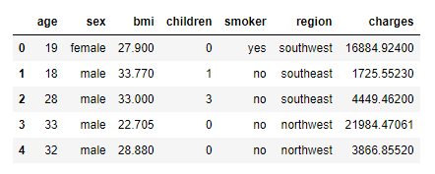
Attributes effecting the Claiming of Insurance
Health insurance differs from individual to individual depending on some parameters.
There are many parameters effecting the claiming of the insurance.
Parameters are:
i. Age
Salary
Habits
BMI – Body Mass Index
Region

Slide 5
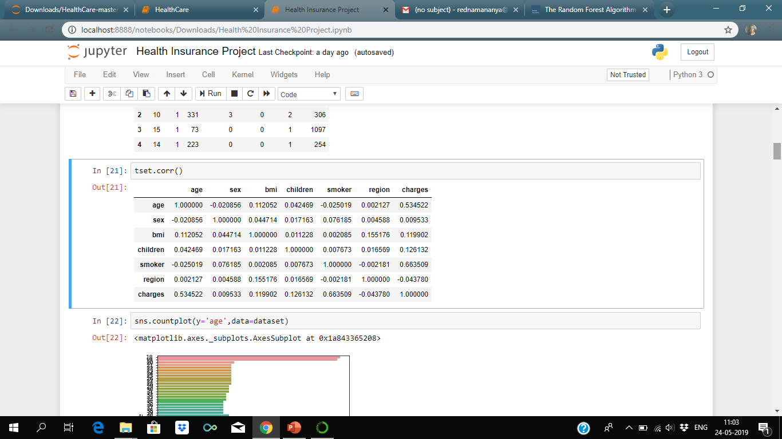
Correlation among the attributes
Correlation is a mutual relationship or connection between two or more attributes.
The best correlation is between smoker and charges, and next between age and charges.
All the other attributes i.e., sex , BMI, children shows positive correlation.
There is a negative correlation between region and charges, so less effect

Slide 6
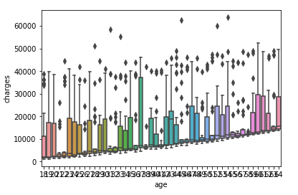
Relation between Age and Charges
Age plays a big role in the cost of a premium for health insurance; generally, younger people have lower premiums, as they are seen as less risky and less likely to require more medical care.
Often, the starting point for an insurance rate is based on that of an individual who is 18 years old.
At 26 the average premium is 1.024 times the base premium, it gets increases as the age gets increased.
If a person is 64 years old, the average health insurance premium is 3 full times what it is at the age of 21.

Slide 7
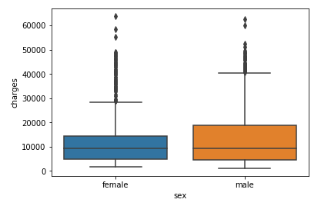
Relation between Gender and Charges
Basing on the gender Females get less insurance than Males. Female pain is marginalized, and women are often told that their pain has psychiatric or emotional rather than physical causes.
“Many Insurers have determined that physical therapy for patients who are neither improving nor regressing is not medically necessary that encompasses may women suffering from pelvic pain who are thrashing around in the health care system without a diagnosis”
Basing on the above statement Male persons get more insurance.

Slide 8
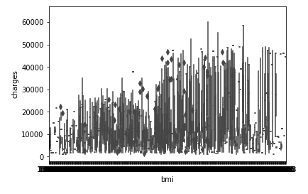
Relation between BMI and Charges
BMI: Body Mass Index, is a score that estimates the amount and types of tissues that makeup a person’s weight. This score is typically used to categorize people into 4 weight classes:
1. Underweight
2. Normal weight
3. Overweight
4. Obesity
Person with Normal Weight gets the highest insurance, then the people with under weight, then the people with overweight and least insurance is given to the people with obesity.

Slide 9
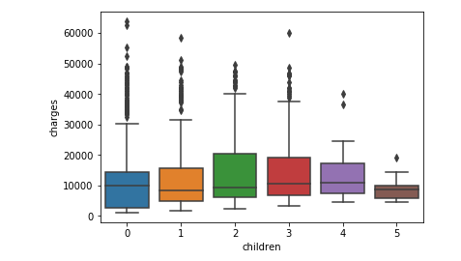
Relation between Children and Charges
The charges are dependent on number of children a person have.
The insurer considers the number of children a person have, basing on this he will provide the insurance.

Slide 10
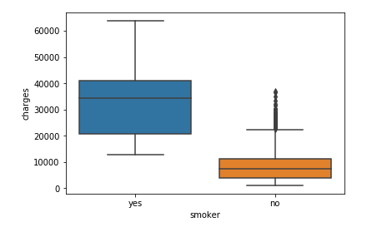
Relation between Smokers and Charges
The premium for health insurance tend to be on the steeper side for smokers. But it isn’t that high as compared to that of non-smoker’s.
However, if the company realises your health is deteriorating owing to your smoking habits, your premiums might be increased, accordingly.
In most cases, being a smoker will automatically heighten your premium amount when compared to a non-smoker.

Slide 11
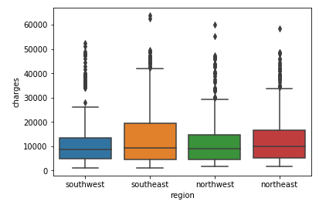
Relation between Region and Charges
The relation between the region and charges can be determined by the climatic conditions over the region.
When the climatic conditions are adverse, the health may deteriorate so that the insurance claimed by the person will be more and vice versa.

Slide 12
Supervised Learning
Supervised Learning, indicates the presence of a supervisor as a teacher.
Basically supervised learning is a learning in which we teach or train the machine using data which is well labeled that means some data is already tagged with the correct answer.
After that, the machine is provided with a new set of examples (data) so that supervised learning algorithm analyses the training data (set of training examples) and produces a correct outcome from labeled data.
Supervised Learning is of two types:
Classification
Regression
For Predicting the Health Insurance we have used Regression because the given dataset cannot be categorised.
Regression techniques:
Linear Regression
Multi Linear Regression
Polynomial Regression
Logistic Regression
Random Forest Regression
Random Forest Regression is predicting the best performance for the testing data for the fitted model.

Slide 13
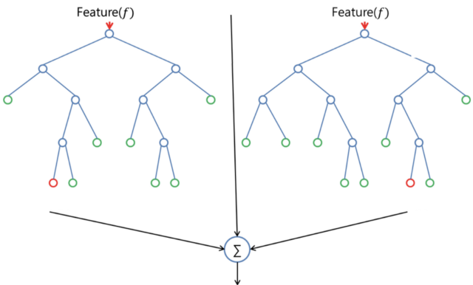
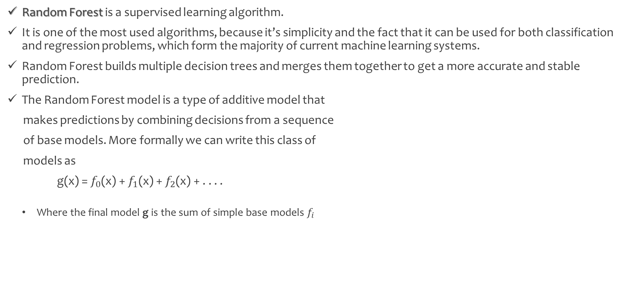
Random Forest Regression
Random Forest is a supervised learning algorithm.
It is one of the most used algorithms, because it’s simplicity and the fact that it can be used for both classification and regression problems, which form the majority of current machine learning systems.
Random Forest builds multiple decision trees and merges them together to get a more accurate and stable prediction.
The Random Forest model is a type of additive model that
makes predictions by combining decisions from a sequence
of base models. More formally we can write this class of
models as
g(x) = $f_{0}$(x) +${ f}_{1}$(x) +$f_{2}$(x) + . . . .
Where the final model g is the sum of simple base models $f_{i}$

Slide 14
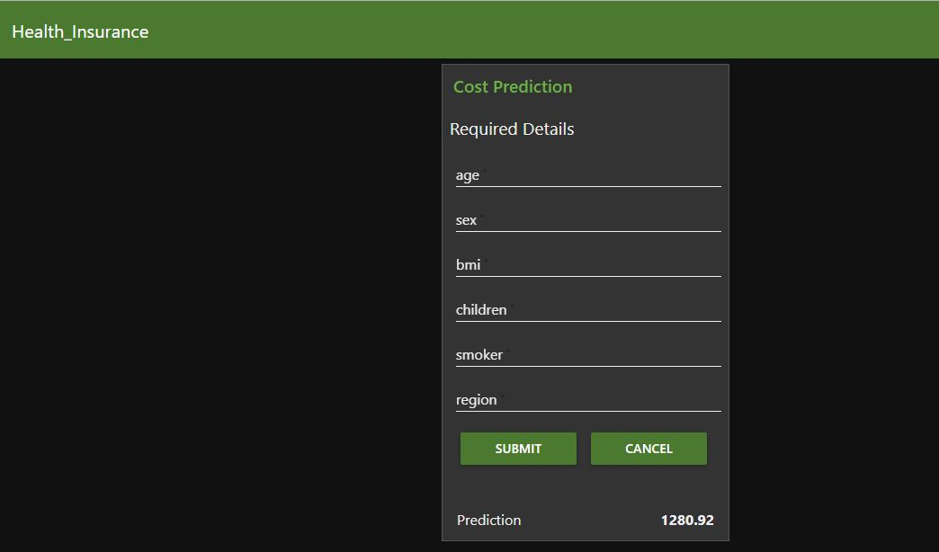
User Interface for Cost Prediction
Input:
To predict the insurance that can be claimed by the person, we need input attributes.
Input attributes are:
1. Age 4. Children
2. Sex 5. Smoker
3. BMI 6. Region
Output:
The output is the cost predicted based om the input values, that how much a person can claim from the insurance.

Slide 15
Conclusion
Health insurance is that it covers the whole or a part of the risk of a person incurring medical expenses .
Health insurance provides people with a much needed financial backup at times of medical emergencies.
There are different types of health insurance plans, such as individual health insurance, family health insurance, critical illness insurance, etc.
The preferred approach to Health Insurance - Cost Prediction is cost prediction using supervised learning methods, in supervised learning we have used Regression techniques as the dataset cannot be categorized.
We can use many Regression techniques, in which “Random Forest Regression” technique has given the “Highest Performance”.
When the attributes in the dataset are been correlated with the target attribute i.e., Charges, the attributes age and smoker are effecting more on the performance of the model than the other attributes in the dataset.

Slide 16

Thank You
Coding Strikers

